Slide 1
Chapter 3: CPU Scheduling

Slide 2
Outline
Basic Concepts
Scheduling Criteria
Scheduling Algorithms
Multi-Processor Scheduling
Real-Time CPU Scheduling

Slide 3
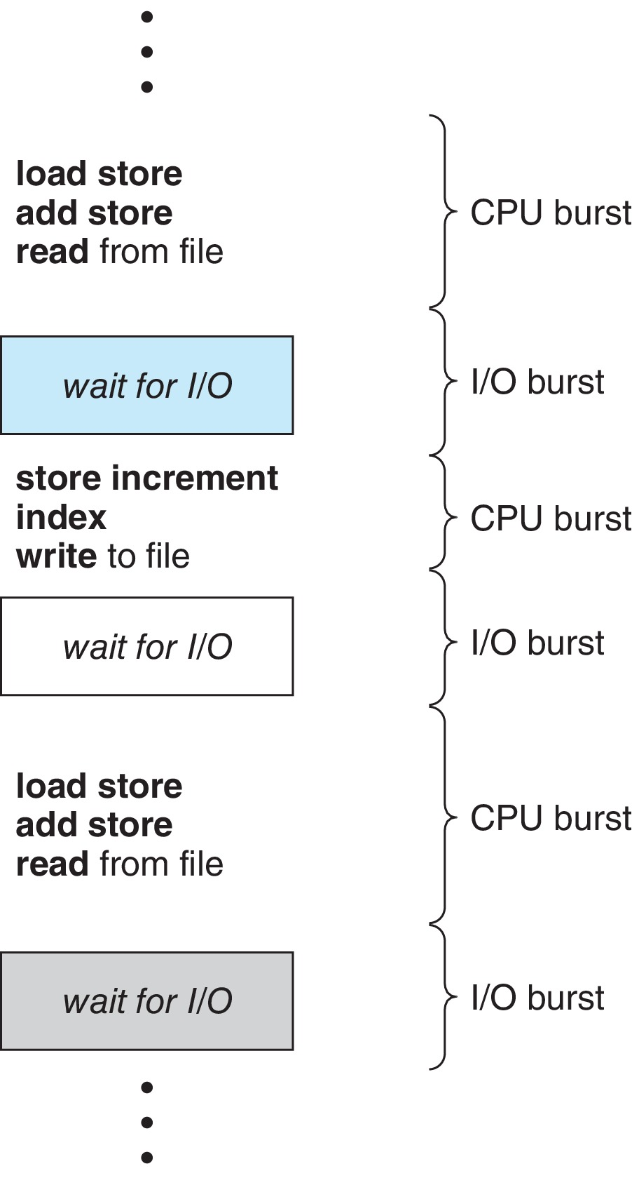
Basic Concepts
Maximum CPU utilization obtained with multiprogramming
CPU–I/O Burst Cycle – Process execution consists of a cycle of CPU execution and I/O wait
CPU burst followed by I/O burst
CPU burst distribution is of main concern

Slide 4
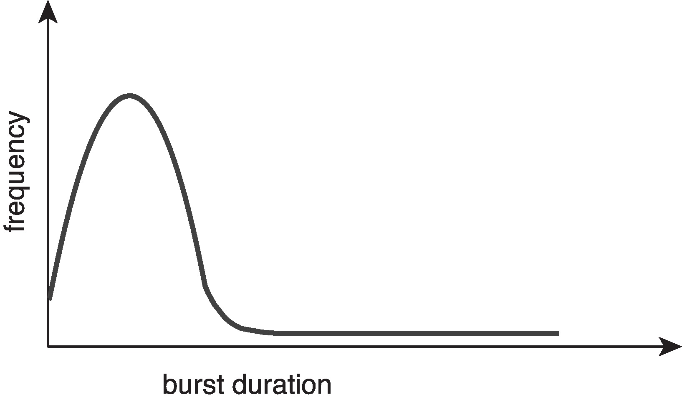
Histogram of CPU-burst Times
Large number of short bursts
Small number of longer bursts

Slide 5
CPU Scheduler
The CPU scheduler selects from among the processes in ready queue, and allocates a CPU core to one of them
Queue may be ordered in various ways
CPU scheduling decisions may take place when a process:
1. Switches from running to waiting state
2. Switches from running to ready state
3. Switches from waiting to ready
Terminates
For situations 1 and 4, there is no choice in terms of scheduling. A new process (if one exists in the ready queue) must be selected for execution.
For situations 2 and 3, however, there is a choice.

Slide 6
Preemptive and Nonpreemptive Scheduling
When scheduling takes place only under circumstances 1 and 4, the scheduling scheme is nonpreemptive.
Otherwise, it is preemptive.
Under Nonpreemptive scheduling, once the CPU has been allocated to a process, the process keeps the CPU until it releases it either by terminating or by switching to the waiting state.
Virtually all modern operating systems including Windows, MacOS, Linux, and UNIX use preemptive scheduling algorithms.

Slide 7
Preemptive Scheduling and Race Conditions
Preemptive scheduling can result in race conditions when data are shared among several processes.
Consider the case of two processes that share data. While one process is updating the data, it is preempted so that the second process can run. The second process then tries to read the data, which are in an inconsistent state.
This issue will be explored in detail in Chapter 6.

Slide 8
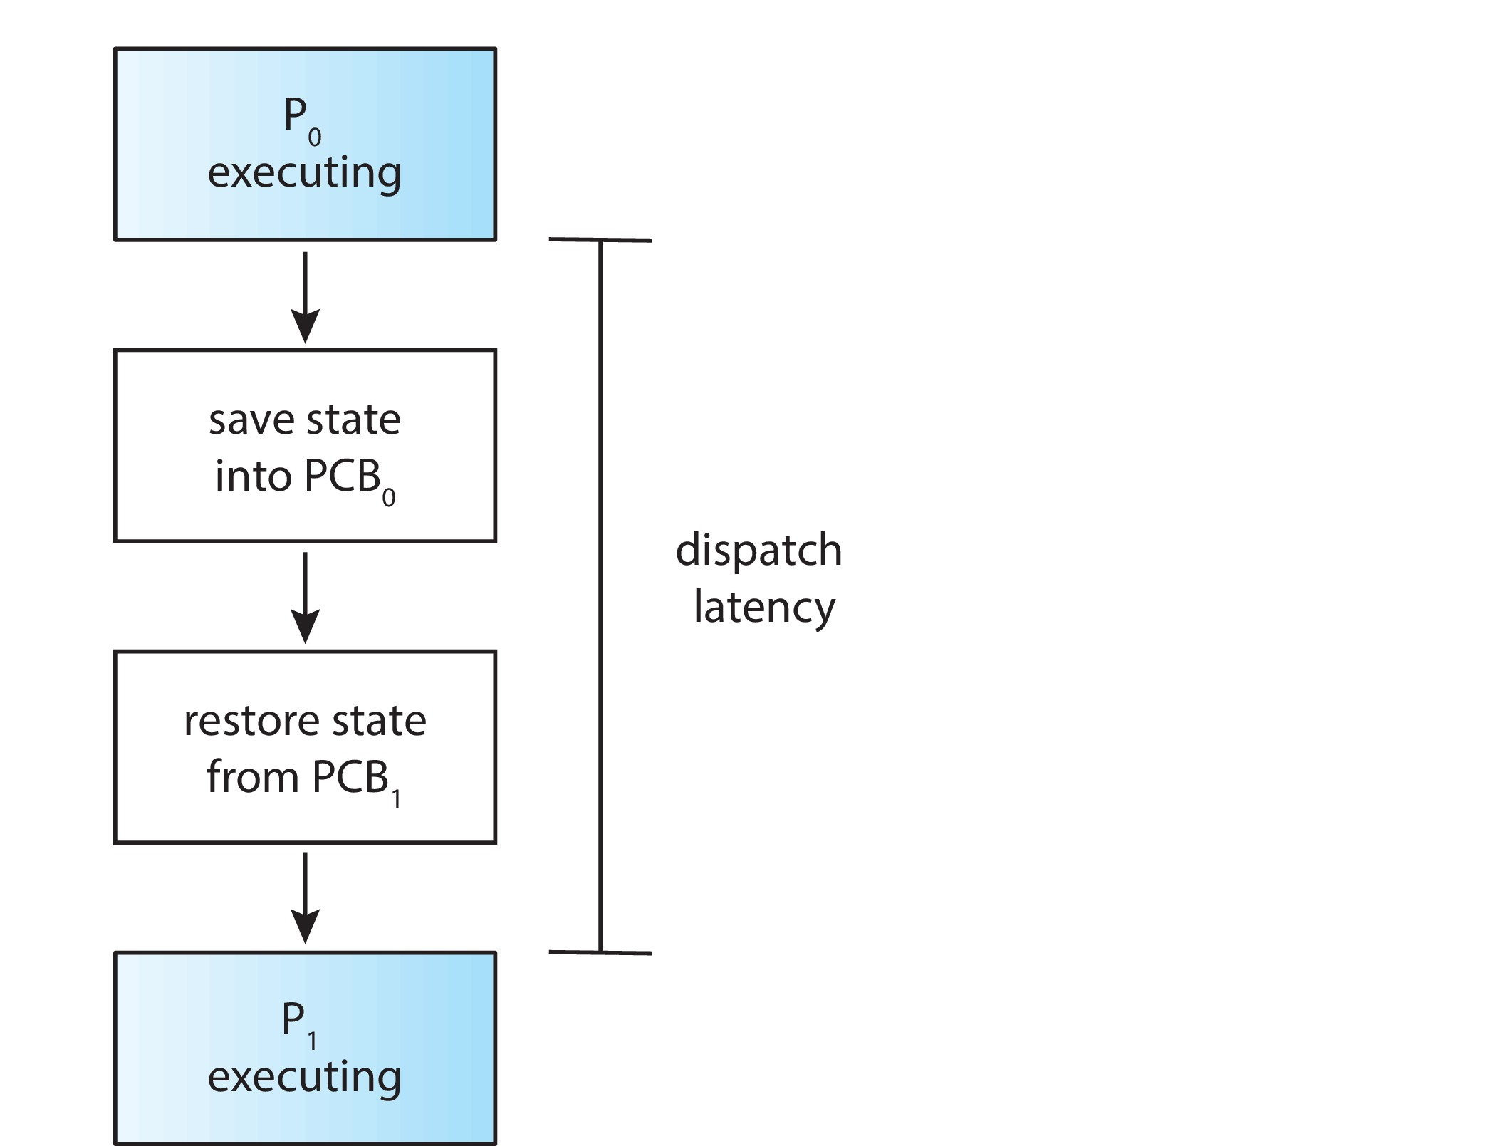
Dispatcher
Dispatcher module gives control of the CPU to the process selected by the CPU scheduler; this involves:
Switching context
Switching to user mode
Jumping to the proper location in the user program to restart that program
Dispatch latency – time it takes for the dispatcher to stop one process and start another running

Slide 9
Scheduling Criteria
CPU utilization – keep the CPU as busy as possible
Throughput – # of processes that complete their execution per time unit
Turnaround time – amount of time to execute a particular process
Waiting time – amount of time a process has been waiting in the ready queue
Response time – amount of time it takes from when a request was submitted until the first response is produced.

Slide 10
Scheduling Algorithm Optimization Criteria
Max CPU utilization
Max throughput
Min turnaround time
Min waiting time
Min response time

Slide 11
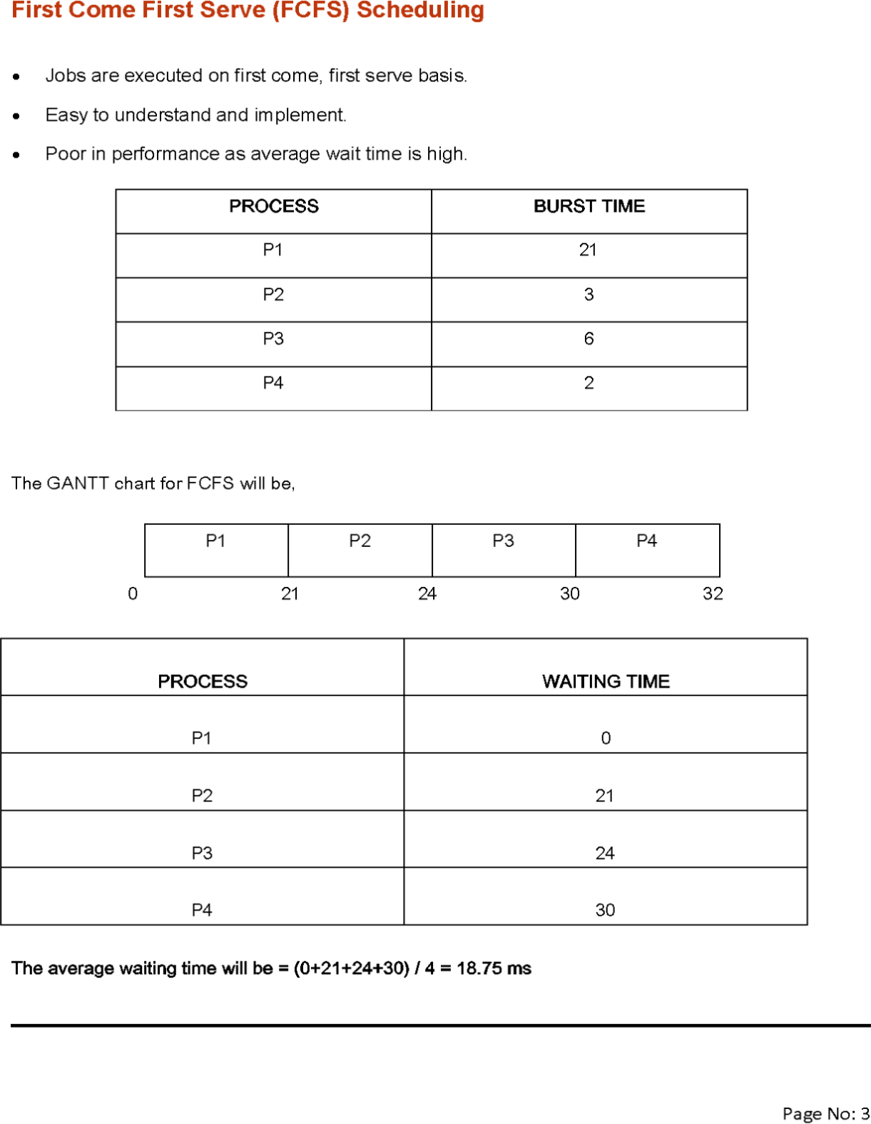
First- Come, First-Served (FCFS) Scheduling
Process Burst Time
P₁ 24
P₂ 3
P₃ 3
Suppose that the processes arrive in the order: P₁ , P₂ , P₃ The Gantt Chart for the schedule is:
Waiting time for P₁ = 0; P₂ = 24; P₃ = 27
Average waiting time: (0 + 24 + 27)/3 = 17

Slide 12
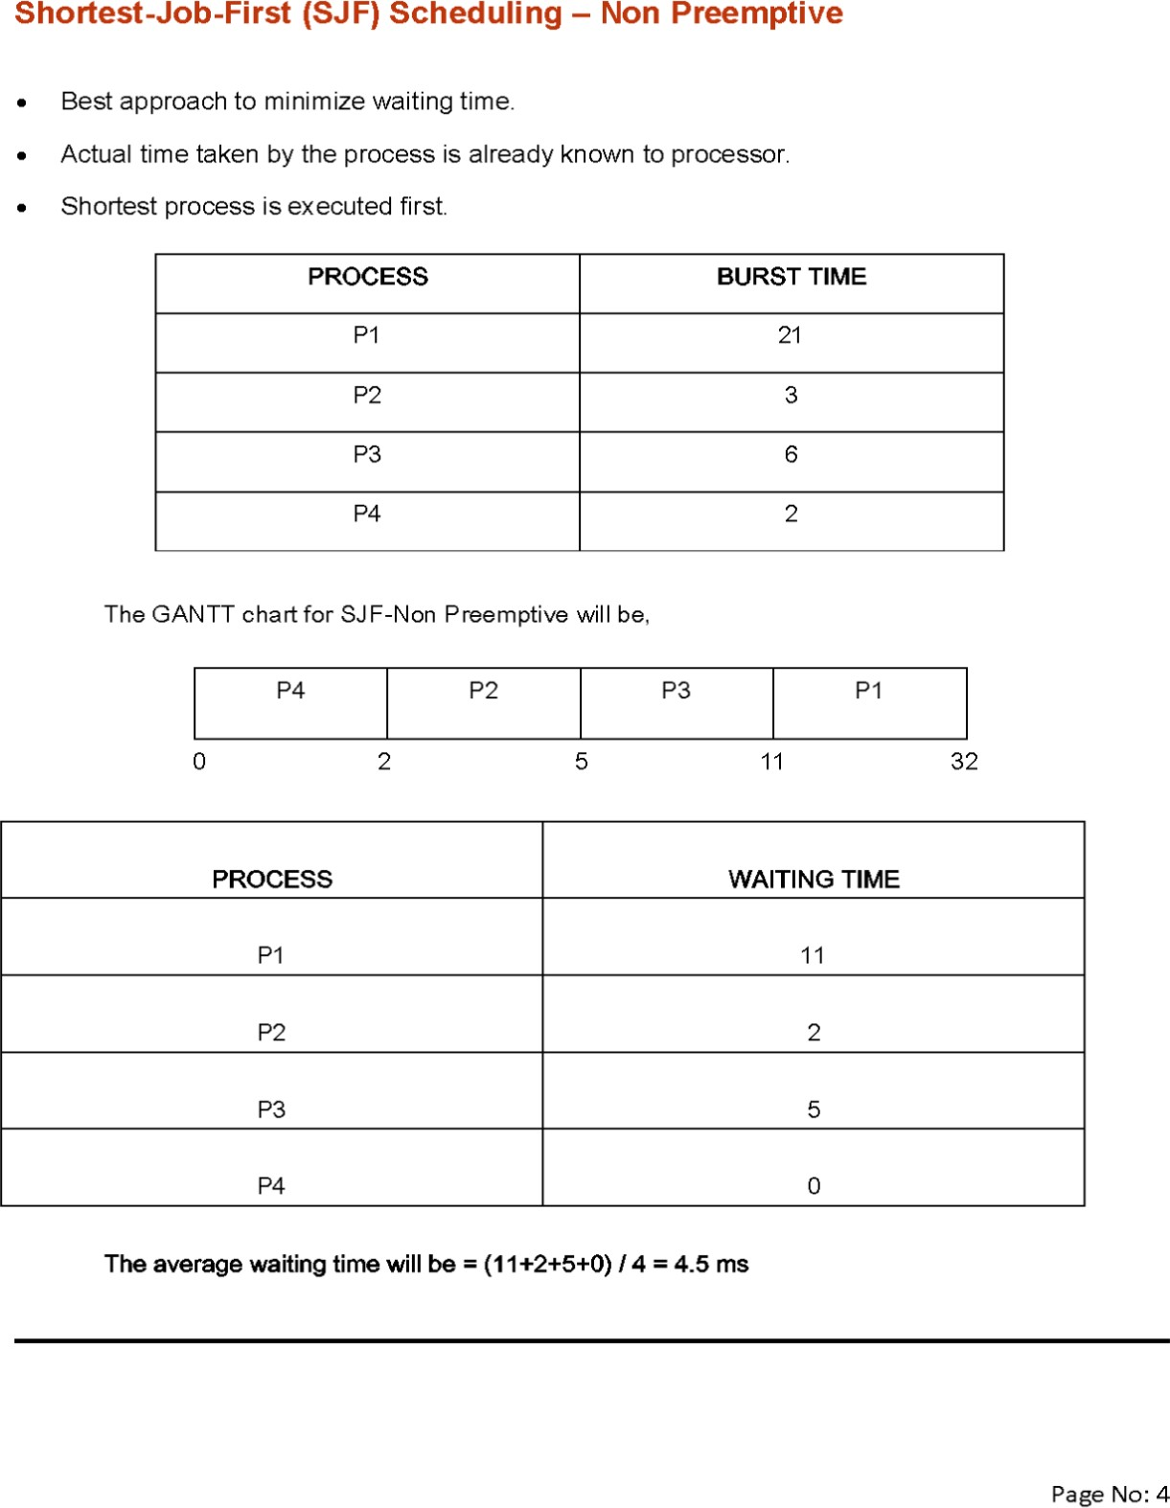
Shortest-Job-First (SJF) Scheduling
Associate with each process the length of its next CPU burst
Use these lengths to schedule the process with the shortest time
SJF is optimal – gives minimum average waiting time for a given set of processes
Preemptive version called shortest-remaining-time-first
How do we determine the length of the next CPU burst?
Could ask the user
Estimate

Slide 13
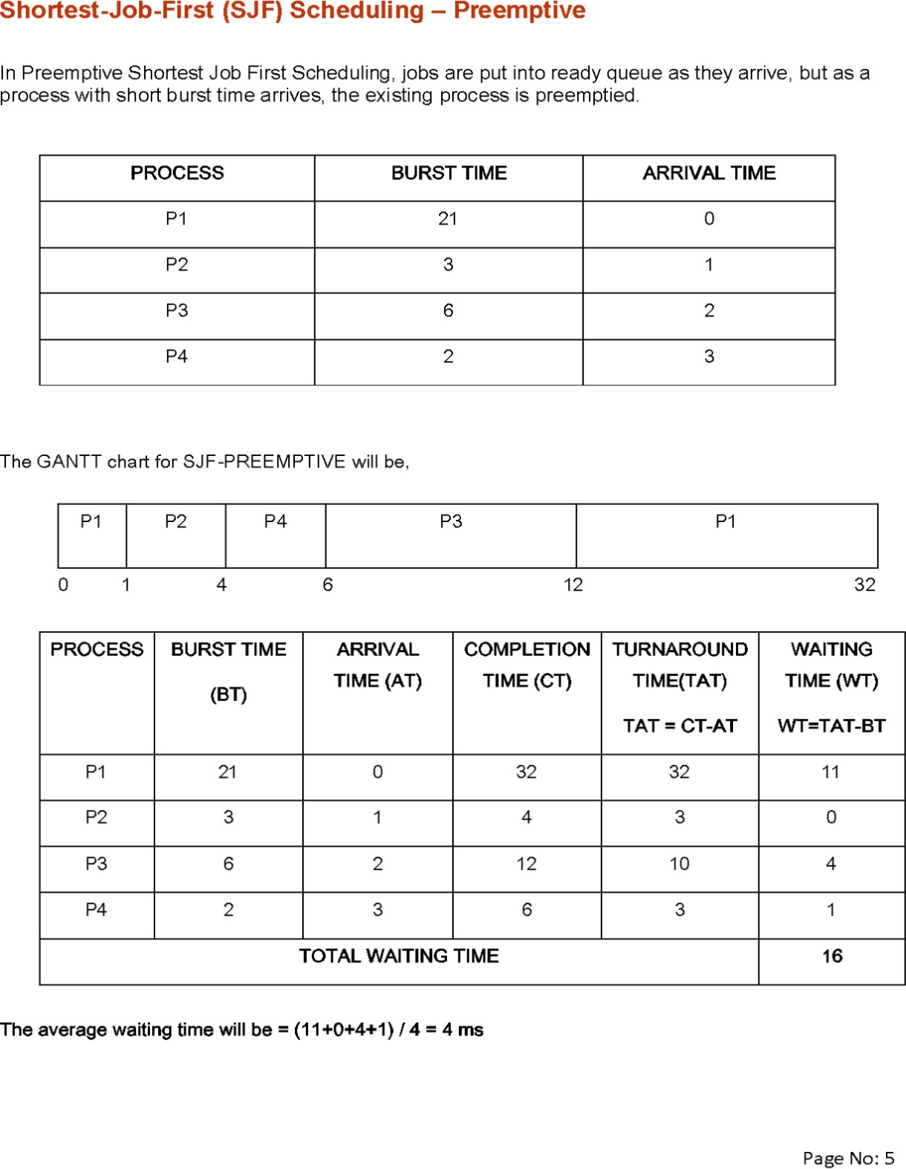
Example of SJF(Preemptive)
Process Burst Time
P₁ 6
P₂ 8
P₃ 7
P₄ 3
SJF scheduling chart
Average waiting time = (3 + 16 + 9 + 0) / 4 = 7

Slide 14
Round Robin (RR)
A fixed time is allocated to each process, called quantum for each execution
Only a process is executed for given time period that process is preempted and other process executes for given time period
Context switching is used to save states of preempted processes.
Assume time quantum as 5ms
Gantt Chart
0 5 8 13 15 20 21 32
Process | Burst time
P1 | 21
P2 | 3
P3 | 6
P4 | 2
P1 | P2 | P3 | P4 | P1 | P3 | P1
Process | Waiting Time = Completion Time – Burst time
P1 | =(32-21)➔11
P2 | =(8-3)➔5
P3 | =(21-6)➔15
P4 | =(15-2)➔13
Total Waiting Time | =44
Average Waiting Time | =44/4 ➔11 ms

Slide 15
Priority Scheduling
Priority is assigned for each process.
Process with highest priority is executed first and so on.
Process with same priority are executed in FCFS manner.
Priority can be decided on memory requirements, time requirements or any other resource requirements
Gantt Chart
0 3 24 26 32
Waiting Time
Total Wt = 53
AWT =53/4 = 18.75ms
Proces | Burst Time | Priority
P1 | 21 | 2
P2 | 3 | 1 (Highest)
P3 | 6 | 4 (Lowest
P4 | 2 | 3
P2 | P1 | P4 | P3
Process | Waiting Time
P1 | 3
P2 | 0
P3 | 26
P4 | 24

Slide 16
Multilevel Queue
The ready queue consists of multiple queues
Multilevel queue scheduler defined by the following parameters:
Number of queues
Scheduling algorithms for each queue
Method used to determine which queue a process will enter when that process needs service
Scheduling among the queues

Slide 17
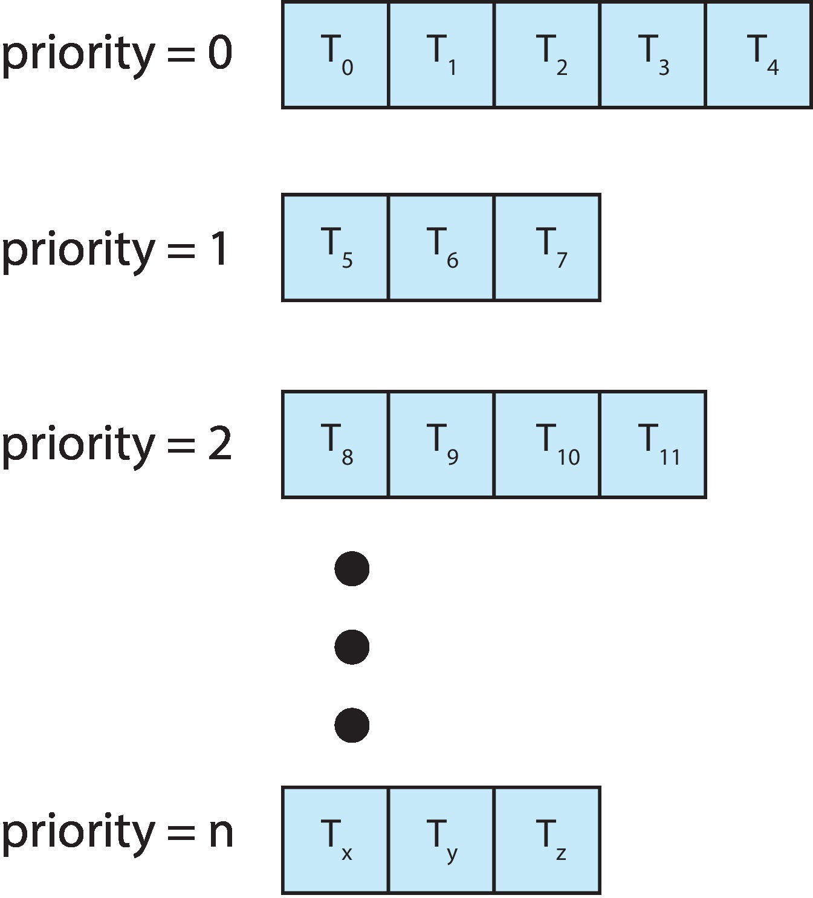
Multilevel Queue
With priority scheduling, have separate queues for each priority.
Schedule the process in the highest-priority queue!

Slide 18
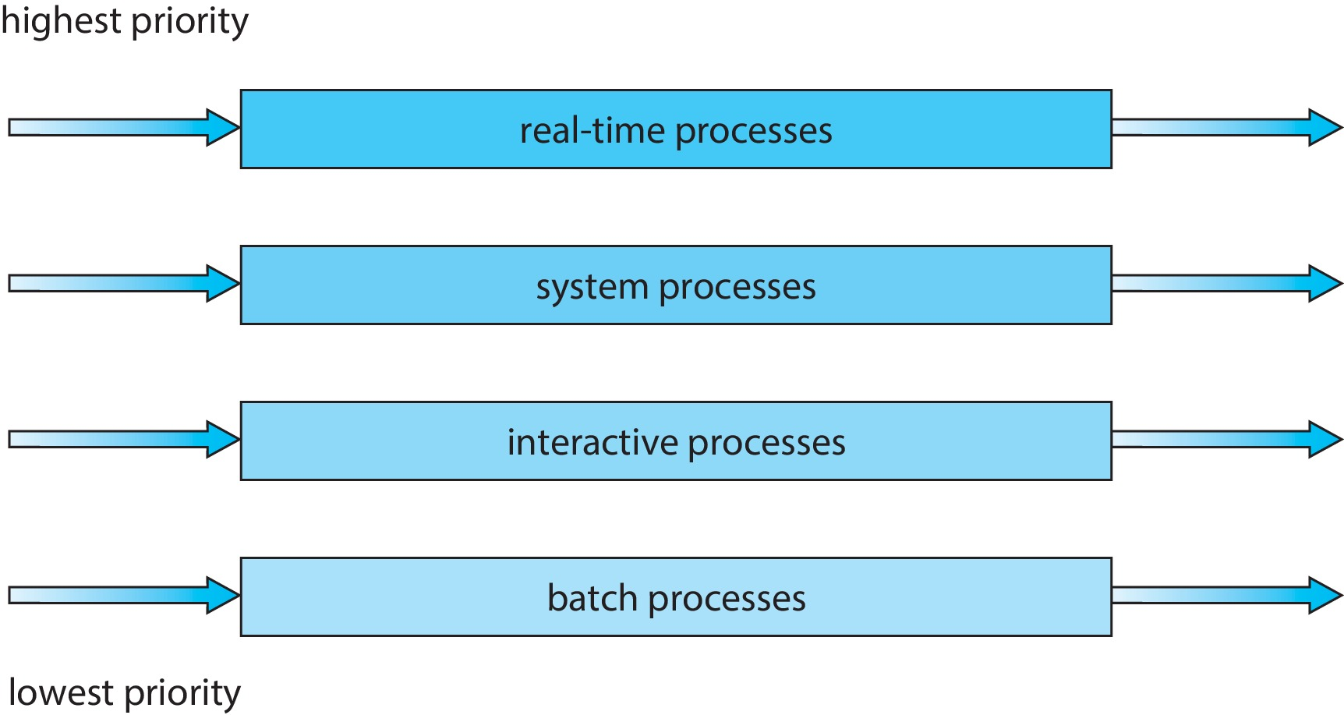
Multilevel Queue
Prioritization based upon process type

Slide 19
Multilevel Feedback Queue (Self Study)
A process can move between the various queues.
Multilevel-feedback-queue scheduler defined by the following parameters:
Number of queues
Scheduling algorithms for each queue
Method used to determine when to upgrade a process
Method used to determine when to demote a process
Method used to determine which queue a process will enter when that process needs service
Aging can be implemented using multilevel feedback queue

Slide 20
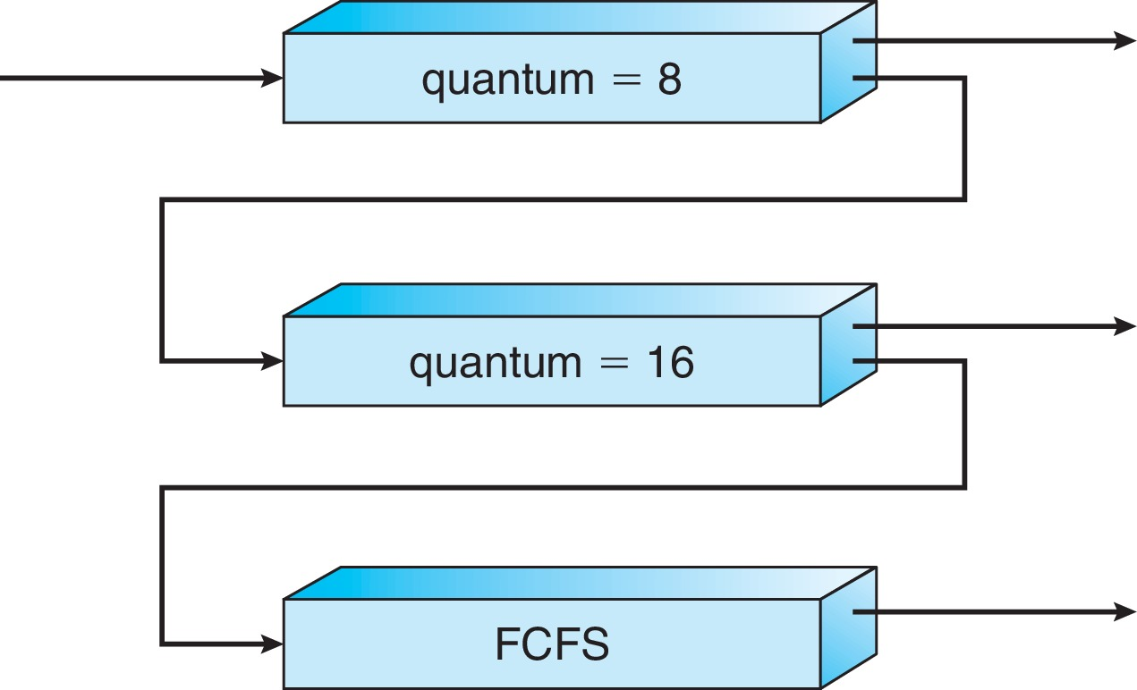
Example of Multilevel Feedback Queue (Self Study)
Three queues:
Q₀ – RR with time quantum 8 milliseconds
Q₁ – RR time quantum 16 milliseconds
Q₂ – FCFS
Scheduling
A new process enters queue Q₀ which is served in RR
When it gains CPU, the process receives 8 milliseconds
If it does not finish in 8 milliseconds, the process is moved to queue Q₁
At Q₁ job is again served in RR and receives 16 additional milliseconds
If it still does not complete, it is preempted and moved to queue Q₂

Slide 21
Multiple-Processor Scheduling
CPU scheduling more complex when multiple CPUs are available
Multiprocess may be any one of the following architectures:
Multicore CPUs
Multithreaded cores
NUMA systems
Heterogeneous multiprocessing

Slide 22
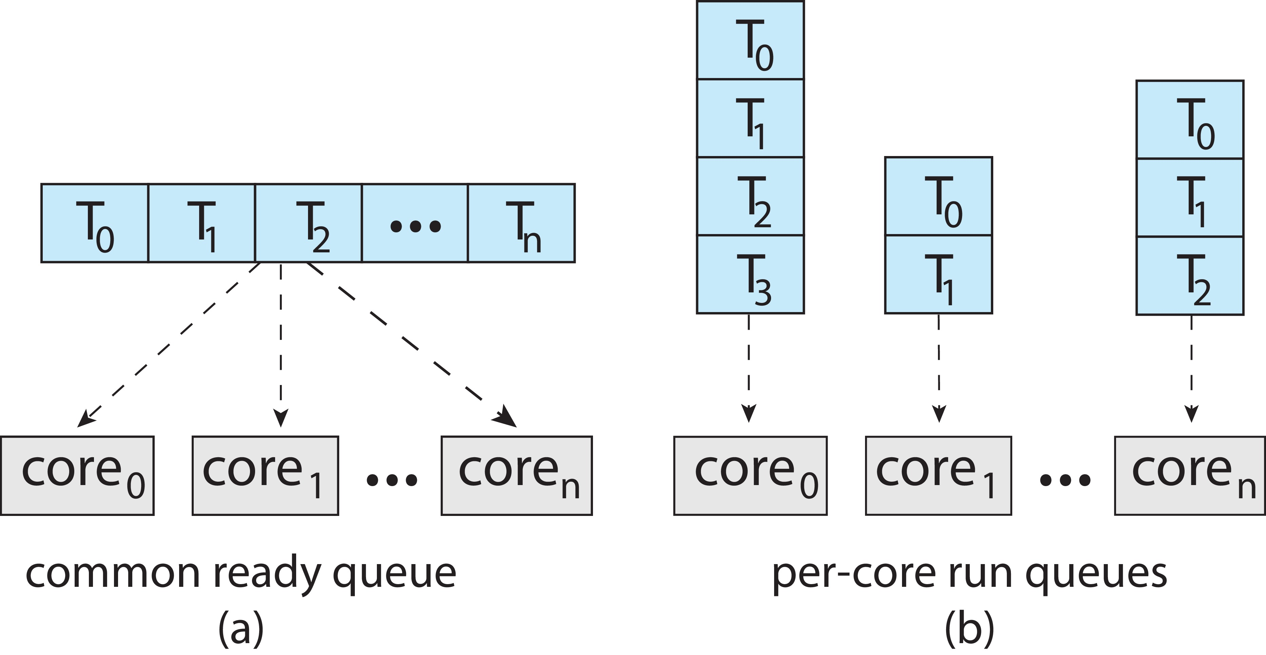
Multiple-Processor Scheduling
Symmetric multiprocessing (SMP) is where each processor is self scheduling.
All threads may be in a common ready queue (a)
Each processor may have its own private queue of threads (b)

Slide 23
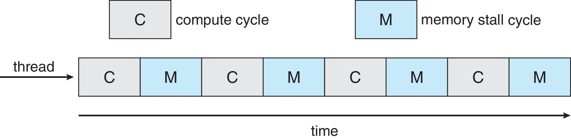
Multicore Processors
Recent trend to place multiple processor cores on same physical chip
Faster and consumes less power
Multiple threads per core also growing
Takes advantage of memory stall to make progress on another thread while memory retrieve happens
Figure

Slide 24
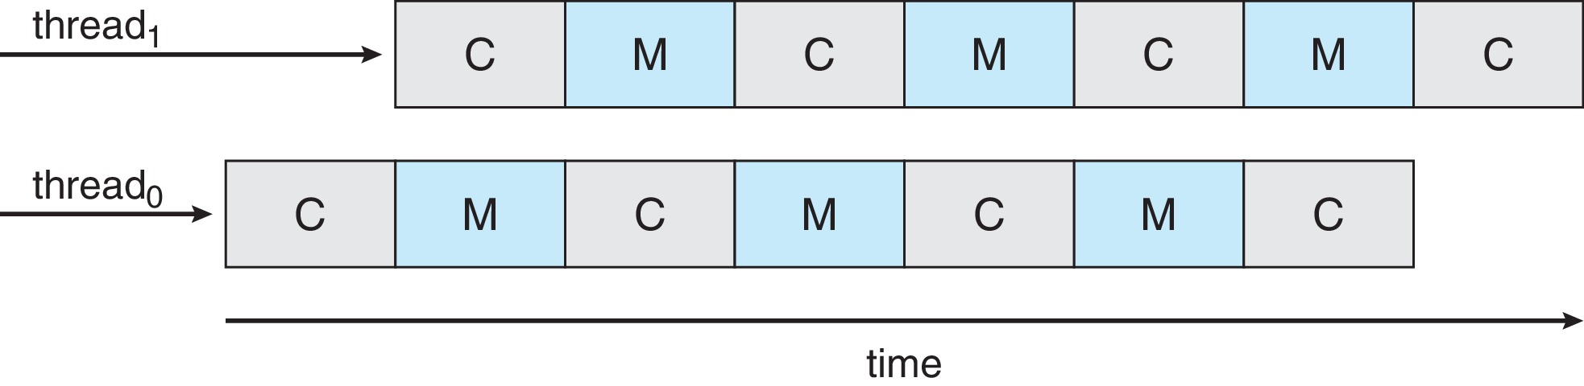
Multithreaded Multicore System (Self Study)
Each core has > 1 hardware threads.
If one thread has a memory stall, switch to another thread!
Figure

Slide 25
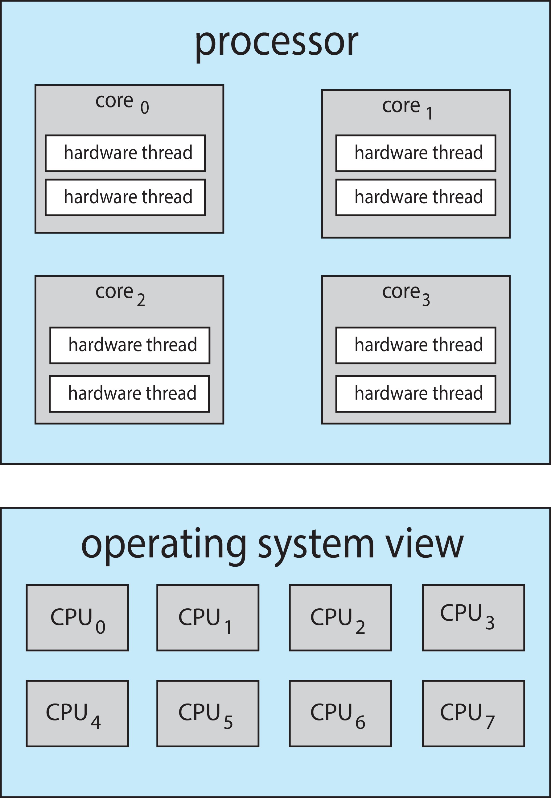
Multithreaded Multicore System (Self Study)
Chip-multithreading (CMT) assigns each core multiple hardware threads. (Intel refers to this as hyperthreading.)
On a quad-core system with 2 hardware threads per core, the operating system sees 8 logical processors.

Slide 26
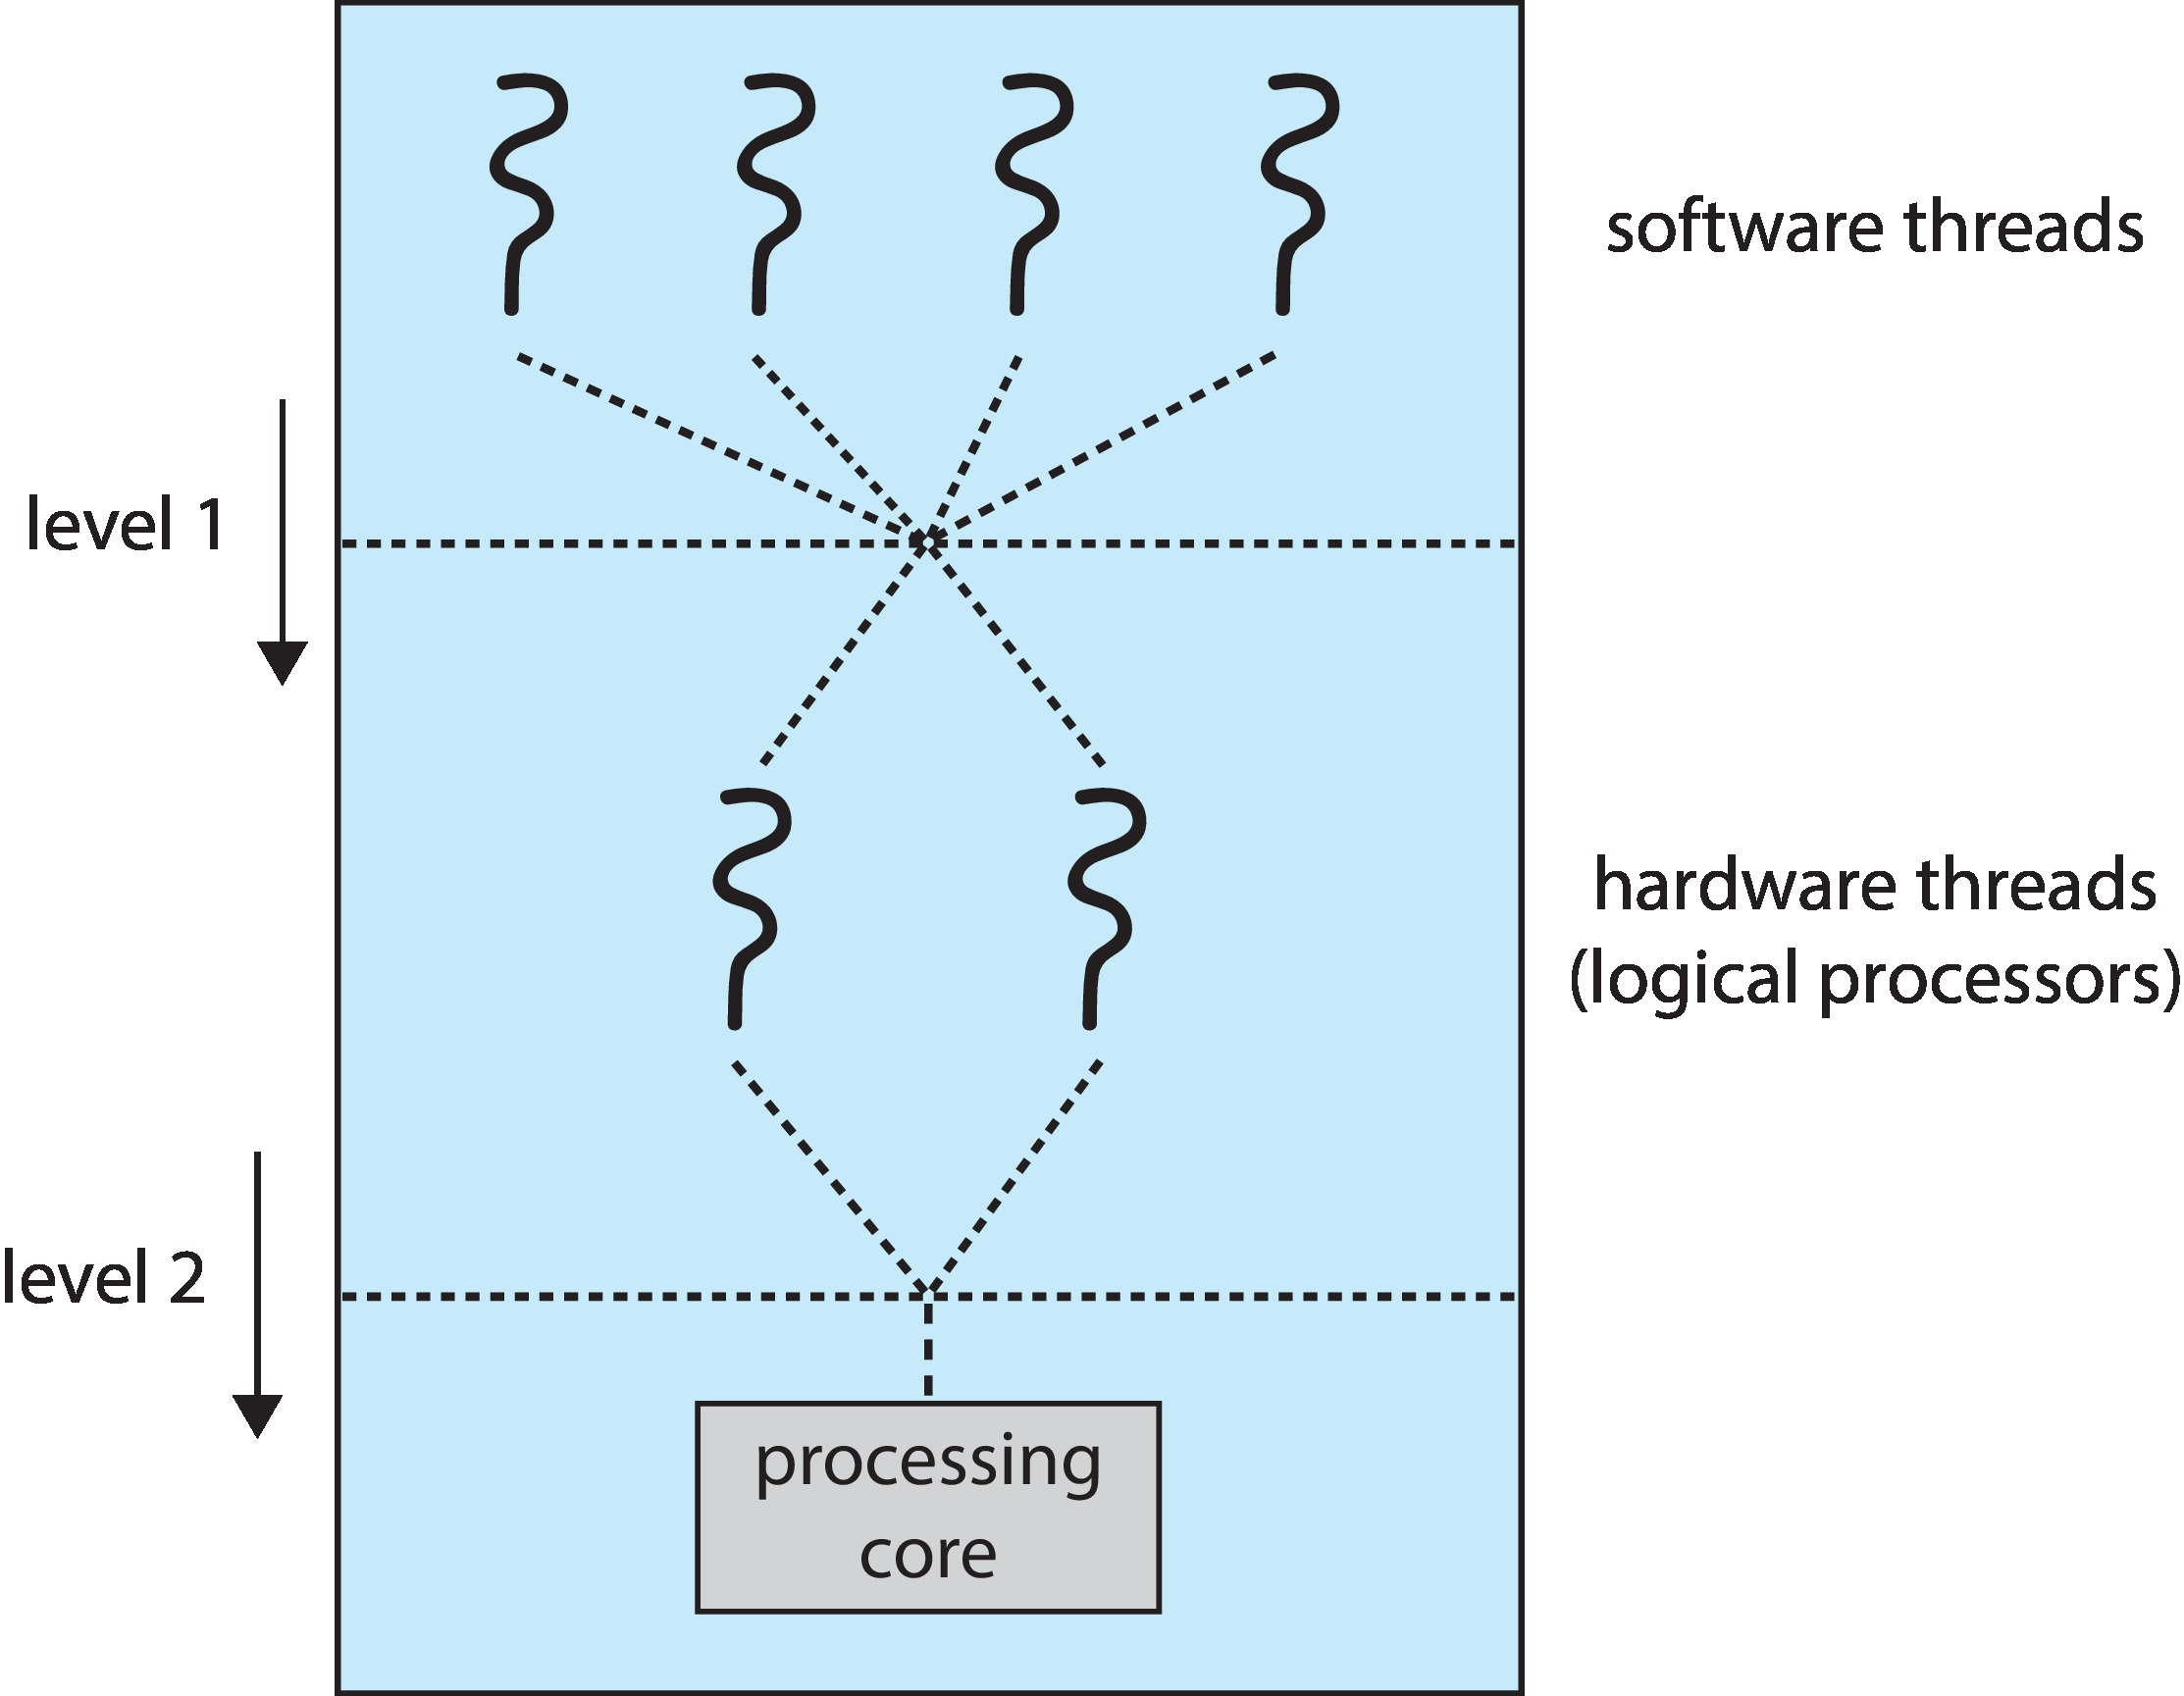
Multithreaded Multicore System (Self Study)
Two levels of scheduling:
The operating system deciding which software thread to run on a logical CPU
How each core decides which hardware thread to run on the physical core.

Slide 27
Multiple-Processor Scheduling – Load Balancing (Self Study)
If SMP, need to keep all CPUs loaded for efficiency
Load balancing attempts to keep workload evenly distributed
Push migration – periodic task checks load on each processor, and if found pushes task from overloaded CPU to other CPUs
Pull migration – idle processors pulls waiting task from busy processor

Slide 28
Multiple-Processor Scheduling – Processor Affinity (Self Study)
When a thread has been running on one processor, the cache contents of that processor stores the memory accesses by that thread.
We refer to this as a thread having affinity for a processor (i.e., “processor affinity”)
Load balancing may affect processor affinity as a thread may be moved from one processor to another to balance loads, yet that thread loses the contents of what it had in the cache of the processor it was moved off of.
Soft affinity – the operating system attempts to keep a thread running on the same processor, but no guarantees.
Hard affinity – allows a process to specify a set of processors it may run on.

Slide 29
NUMA and CPU Scheduling (Self Study)
If the operating system is NUMA-aware, it will assign memory closes to the CPU the thread is running on.

Slide 30
Real-Time CPU Scheduling
Can present obvious challenges
Soft real-time systems – Critical real-time tasks have the highest priority, but no guarantee as to when tasks will be scheduled
Hard real-time systems – task must be serviced by its deadline

Slide 31
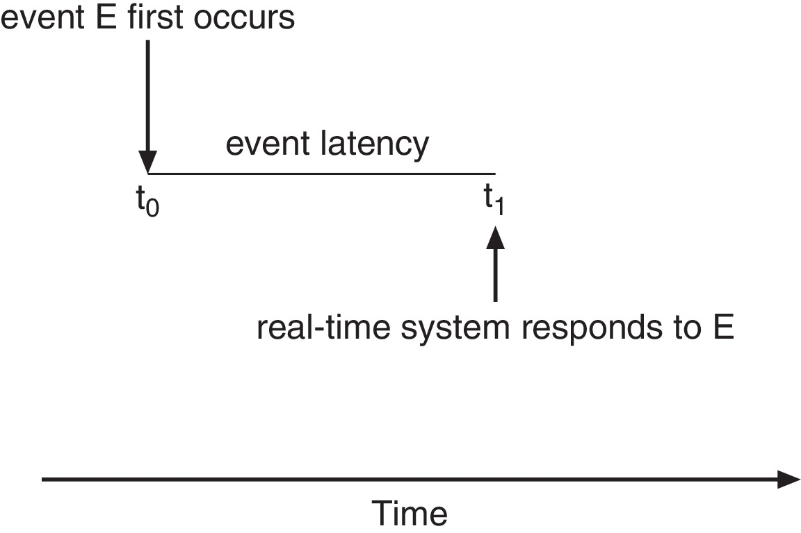
Real-Time CPU Scheduling
Event latency – the amount of time that elapses from when an event occurs to when it is serviced.
Two types of latencies affect performance
Interrupt latency – time from arrival of interrupt to start of routine that services interrupt
Dispatch latency – time for schedule to take current process off CPU and switch to another

Slide 32
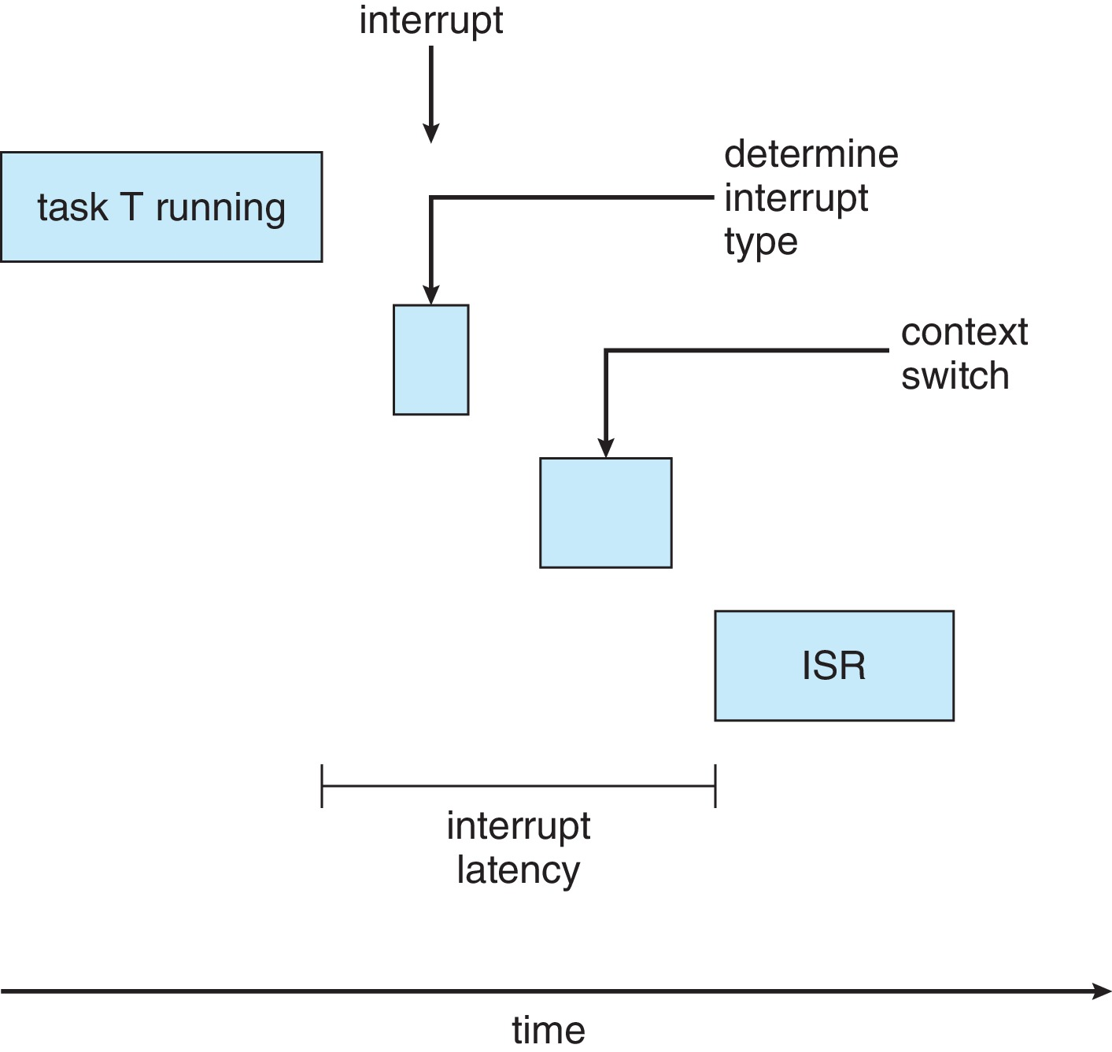
Interrupt Latency (Self Study)

Slide 33
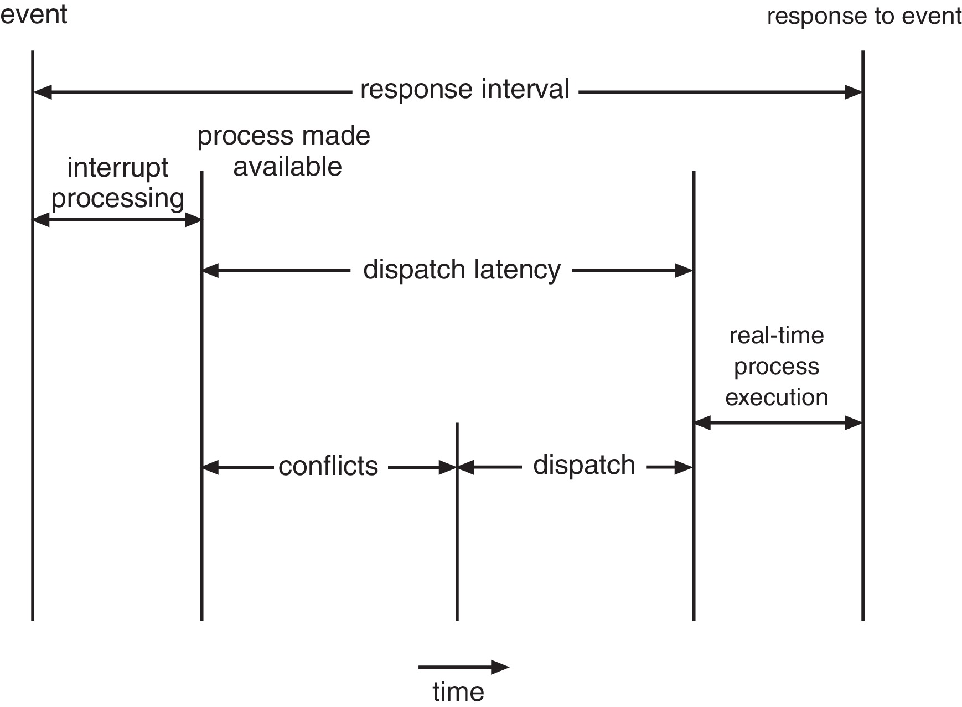
Dispatch Latency (Self Study)
Conflict phase of dispatch latency:
Preemption of any process running in kernel mode
Release by low-priority process of resources needed by high-priority processes

Slide 34
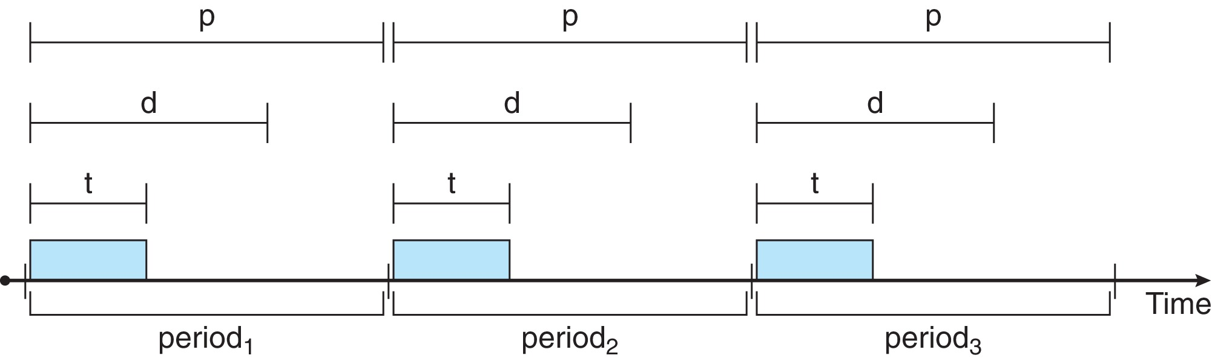
Priority-based Scheduling (Self Study)
For real-time scheduling, scheduler must support preemptive, priority-based scheduling
But only guarantees soft real-time
For hard real-time must also provide ability to meet deadlines
Processes have new characteristics: periodic ones require CPU at constant intervals
Has processing time t, deadline d, period p
0 ≤ t ≤ d ≤ p
Rate of periodic task is 1/p

Slide 35
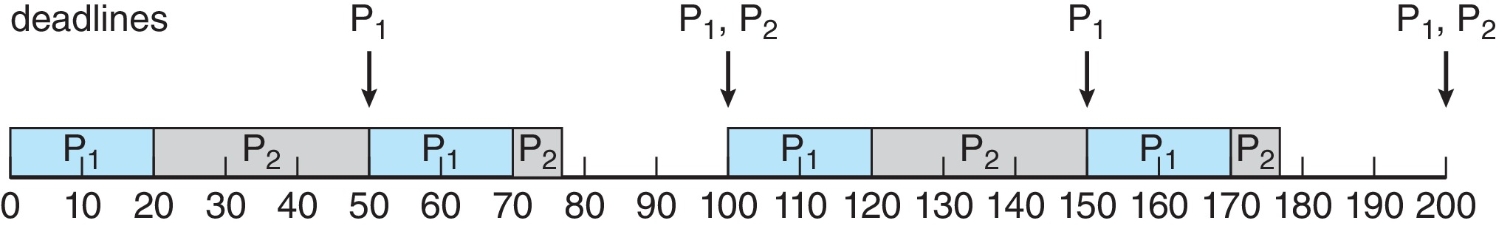
Rate Monotonic Scheduling (Self Study)
A priority is assigned based on the inverse of its period
Shorter periods = higher priority;
Longer periods = lower priority
P₁ is assigned a higher priority than P₂.

Slide 36
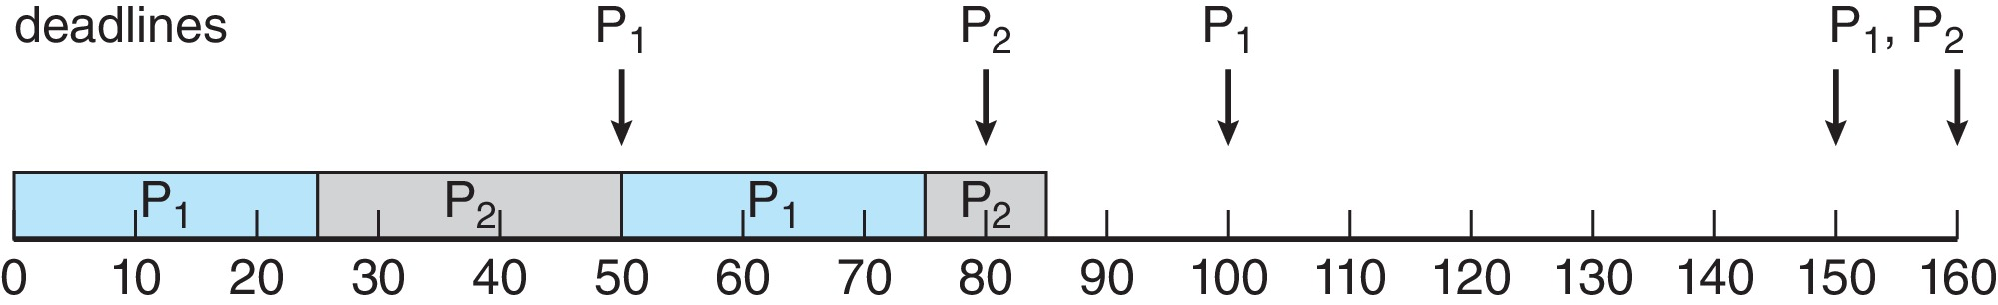
Missed Deadlines with Rate Monotonic Scheduling (Self Study)
Process P₂ misses finishing its deadline at time 80
Figure

Slide 37
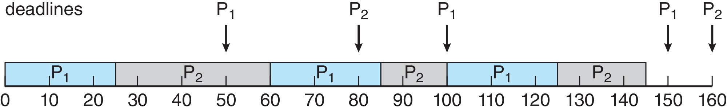
Earliest Deadline First Scheduling (EDF) (Self Study)
Priorities are assigned according to deadlines:
The earlier the deadline, the higher the priority
The later the deadline, the lower the priority
Figure

Slide 38
Proportional Share Scheduling (Self Study)
T shares are allocated among all processes in the system
An application receives N shares where N < T
This ensures each application will receive N / T of the total processor time

Slide 39
POSIX Real-Time Scheduling (Self Study)
The POSIX.1b standard
API provides functions for managing real-time threads
Defines two scheduling classes for real-time threads:
SCHED_FIFO - threads are scheduled using a FCFS strategy with a FIFO queue. There is no time-slicing for threads of equal priority
SCHED_RR - similar to SCHED_FIFO except time-slicing occurs for threads of equal priority
Defines two functions for getting and setting scheduling policy:
pthread_attr_getsched_policy(pthread_attr_t *attr, int *policy)
pthread_attr_setsched_policy(pthread_attr_t *attr, int policy)

Slide 40
End of Chapter 3

